Slide 1
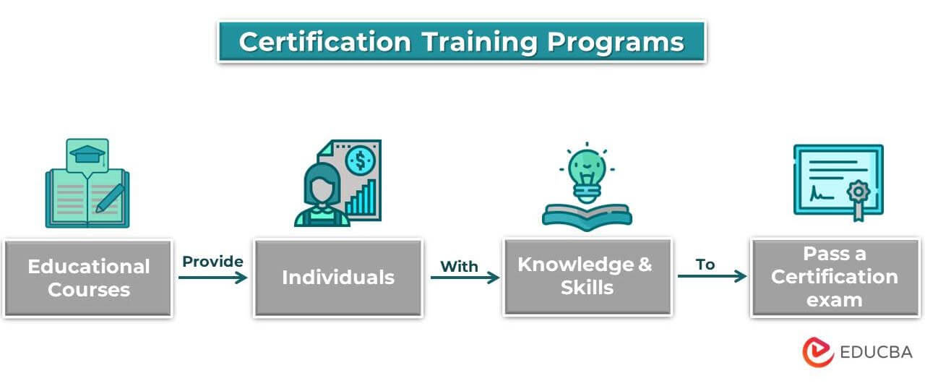
Database Management System – PBL
Training Programme
and Certification
Management System
Review 2 — Week 11
by
K Anirudh Pratap Singh Sambyal
AIML RHINOS • 25WU0102111

Slide 2
WHAT THIS REVIEW COVERS
Review 2 — Agenda
01
Normalized Database Design
Functional dependencies and normalization up to 3NF
02
Data Dictionary
Concise reference for all tables and attributes
03
DDL Scripts & Constraints
CREATE TABLE statements with all integrity constraints
04
Sample Data & SQL Queries
Joins, subqueries, aggregation and views
05
Database Prototype Demo
Implementation progress and working prototype

Slide 3
NORMALIZATION — STEP 1
Functional Dependencies
COURSE
Course_ID → Course_Name, Duration, Category
MODULE
Module_ID → Course_ID, Module_Name, Order
TRAINER
Trainer_ID → Name, Email, Specialization
BATCH
Batch_ID → Course_ID, Trainer_ID, Start_Date, Capacity
LEARNER
Learner_ID → Name, Email, Phone
ENROLMENT
Enrol_ID → Learner_ID, Batch_ID, Enrol_Date, Status
SESSION
Session_ID → Batch_ID, Session_Date, Topic
ATTENDANCE
Attend_ID → Session_ID, Learner_ID, Status
ASSESSMENT
Assess_ID → Batch_ID, Assess_Date, Max_Marks
SCORE
Score_ID → Assess_ID, Learner_ID, Marks_Scored
FEE
Fee_ID → Learner_ID, Amount, Payment_Date
CERTIFICATE
Cert_ID → Learner_ID, Batch_ID, Issue_Date, Cert_Number

Slide 4
NORMALIZATION — STEP 2
1NF → 2NF → 3NF
1NF
2NF
3NF
First Normal Form
Second Normal Form
Third Normal Form
All attributes are atomic. No repeating groups.
No partial dependency — every non-key attribute depends on the whole primary key.
No transitive dependency — non-key attributes depend only on the PK, not on each other.
Each cell holds one value only
ENROLMENT: Learner_ID + Batch_ID → Status (full dependency)
Course details not stored in BATCH (uses Course_ID FK)
Every row is unique (primary key defined)
ATTENDANCE: Session_ID + Learner_ID → Status (full dependency)
Trainer details not stored in BATCH (uses Trainer_ID FK)
No multi-valued columns
SCORE: Assess_ID + Learner_ID → Marks_Scored (full dependency)
Learner details not stored in CERTIFICATE (uses Learner_ID FK)
✓ All 12 tables satisfy 1NF
✓ No partial dependencies found
✓ No transitive dependencies found

Slide 5
CONCISE REFERENCE
Data Dictionary
Table
Attribute
Type
Constraint
Description
COURSE
Course_ID
INT
PK, NOT NULL
Unique course identifier
BATCH
Batch_ID
INT
PK, NOT NULL
Unique batch identifier
BATCH
Capacity
INT
CHECK (>0)
Max learners allowed in batch
LEARNER
Email
VARCHAR
UNIQUE, NOT NULL
Learner contact email
ENROLMENT
Learner_ID
INT
FK + UNIQUE pair
No duplicate enrolment per batch
ENROLMENT
Batch_ID
INT
FK → BATCH
Links enrolment to batch
ATTENDANCE
Status
VARCHAR
CHECK IN list
Present / Absent / Late
SCORE
Marks_Scored
DECIMAL
CHECK (0–Max)
Must be within valid range
CERTIFICATE
Cert_Number
VARCHAR
UNIQUE, NOT NULL
No two certs share a number
CERTIFICATE
Issue_Date
DATE
NOT NULL
Date certificate was issued
FEE
Amount
DECIMAL
CHECK (>0)
Payment must be positive
TRAINER
Specialization
VARCHAR
NOT NULL
Trainer's subject area

Slide 6
DATABASE IMPLEMENTATION
DDL Scripts — Key Tables
BATCH (with capacity constraint)
CREATE TABLE BATCH (
Batch_ID INT PRIMARY KEY,
Course_ID INT NOT NULL,
Trainer_ID INT NOT NULL,
Start_Date DATE NOT NULL,
Capacity INT CHECK (Capacity > 0),
FOREIGN KEY (Course_ID) REFERENCES COURSE(Course_ID),
FOREIGN KEY (Trainer_ID) REFERENCES TRAINER(Trainer_ID)
);
ENROLMENT (no duplicate enrolment)
CREATE TABLE ENROLMENT (
Enrol_ID INT PRIMARY KEY,
Learner_ID INT NOT NULL,
Batch_ID INT NOT NULL,
Enrol_Date DATE NOT NULL,
Status VARCHAR(20) DEFAULT 'Active',
UNIQUE (Learner_ID, Batch_ID),
FOREIGN KEY (Learner_ID) REFERENCES LEARNER(Learner_ID),
FOREIGN KEY (Batch_ID) REFERENCES BATCH(Batch_ID)
);

Slide 7
INTEGRITY CONSTRAINTS
DDL Scripts — Business Rules
SCORE (valid range) + ATTENDANCE (valid status)
CREATE TABLE SCORE (
Score_ID INT PRIMARY KEY,
Assess_ID INT NOT NULL,
Learner_ID INT NOT NULL,
Marks_Scored DECIMAL(5,2) CHECK (Marks_Scored >= 0),
FOREIGN KEY (Assess_ID) REFERENCES ASSESSMENT(Assess_ID),
FOREIGN KEY (Learner_ID) REFERENCES LEARNER(Learner_ID)
);
CREATE TABLE ATTENDANCE (
Attend_ID INT PRIMARY KEY,
Session_ID INT NOT NULL,
Learner_ID INT NOT NULL,
Status VARCHAR(10) CHECK (Status IN ('Present','Absent','Late')),
FOREIGN KEY (Session_ID) REFERENCES SESSION(Session_ID)
);
CERTIFICATE (eligibility + unique number)
CREATE TABLE CERTIFICATE (
Cert_ID INT PRIMARY KEY,
Learner_ID INT NOT NULL,
Batch_ID INT NOT NULL,
Issue_Date DATE NOT NULL,
Cert_Number VARCHAR(50) UNIQUE NOT NULL,
FOREIGN KEY (Learner_ID) REFERENCES LEARNER(Learner_ID),
FOREIGN KEY (Batch_ID) REFERENCES BATCH(Batch_ID)
);

Slide 8
SQL QUERIES
Joins and Subqueries
Batch List — learners per batch with trainer name
SELECT B.Batch_ID, C.Course_Name, T.Name AS Trainer,
COUNT(E.Learner_ID) AS Enrolled
FROM BATCH B
JOIN COURSE C ON B.Course_ID = C.Course_ID
JOIN TRAINER T ON B.Trainer_ID = T.Trainer_ID
JOIN ENROLMENT E ON B.Batch_ID = E.Batch_ID
GROUP BY B.Batch_ID, C.Course_Name, T.Name;
Performance — learners scoring above batch average (subquery)
SELECT L.Name, S.Marks_Scored
FROM SCORE S
JOIN LEARNER L ON S.Learner_ID = L.Learner_ID
WHERE S.Marks_Scored > (
SELECT AVG(Marks_Scored) FROM SCORE
WHERE Assess_ID = S.Assess_ID
);

Slide 9
SQL QUERIES
Aggregation and Views
Trainer Load — sessions and batches assigned per trainer
SELECT T.Name, COUNT(DISTINCT B.Batch_ID) AS Batches,
COUNT(SE.Session_ID) AS Sessions
FROM TRAINER T
JOIN BATCH B ON T.Trainer_ID = B.Trainer_ID
JOIN SESSION SE ON B.Batch_ID = SE.Batch_ID
GROUP BY T.Name;
View — Certificate Status per Learner
CREATE VIEW CertificateStatus AS
SELECT L.Name, C.Course_Name, B.Batch_ID,
CERT.Cert_Number,
COALESCE(CERT.Issue_Date, 'Pending') AS Status
FROM LEARNER L
JOIN ENROLMENT E ON L.Learner_ID = E.Learner_ID
JOIN BATCH B ON E.Batch_ID = B.Batch_ID
JOIN COURSE C ON B.Course_ID = C.Course_ID
LEFT JOIN CERTIFICATE CERT ON L.Learner_ID = CERT.Learner_ID;

Slide 10
SQL QUERIES
Attendance and Fee Reports
Attendance — percentage per learner per batch
SELECT L.Name, B.Batch_ID,
COUNT(CASE WHEN A.Status='Present' THEN 1 END) AS Present,
COUNT(A.Attend_ID) AS Total,
ROUND(COUNT(CASE WHEN A.Status='Present' THEN 1 END)*100.0
/ COUNT(A.Attend_ID), 2) AS Attendance_Pct
FROM ATTENDANCE A
JOIN SESSION SE ON A.Session_ID = SE.Session_ID
JOIN BATCH B ON SE.Batch_ID = B.Batch_ID
JOIN LEARNER L ON A.Learner_ID = L.Learner_ID
GROUP BY L.Name, B.Batch_ID;
Fee Status — total paid per learner
SELECT L.Name, SUM(F.Amount) AS Total_Paid
FROM FEE F
JOIN LEARNER L ON F.Learner_ID = L.Learner_ID
GROUP BY L.Name
ORDER BY Total_Paid DESC;

Slide 11
SAMPLE DATA
Populated Tables — Example Records
BATCH
ENROLMENT
Batch_ID
Course_ID
Trainer_ID
Capacity
Enrol_ID
Learner_ID
Batch_ID
Status
B001
C001
T001
30
E001
L001
B001
Active
B002
C002
T002
25
E002
L002
B001
Active
B003
C001
T001
20
E003
L001
B002
Completed
SCORE
CERTIFICATE
Score_ID
Assess_ID
Learner_ID
Marks
Cert_ID
Learner_ID
Batch_ID
Cert_No
SC001
A001
L001
82.5
CT001
L001
B001
CERT-2025-001
SC002
A001
L002
91.0
CT002
L002
B001
CERT-2025-002
SC003
A002
L001
74.0

Slide 12
IMPLEMENTATION PROGRESS
Database Prototype — What's Built
✅
All 12 Tables Created
✅
Sample Data Inserted
Full DDL executed in MySQL with PK, FK, CHECK and UNIQUE constraints in place.
Realistic data across COURSE, BATCH, LEARNER, ENROLMENT, SESSION, ATTENDANCE, SCORE, FEE and CERTIFICATE.
✅
SQL Queries Tested
✅
Views Created
Joins, subqueries, aggregation and views all tested and returning correct results.
CertificateStatus, AttendanceSummary, and TrainerLoad views are working.
🔄
Python App — In Progress
⏳
Reporting Module
Database connected via mysql-connector-python. CRUD operations for core modules underway.
Report generation for batch lists, performance, fees and certificate status — planned for Review 3.

Slide 13
LOOKING AHEAD
Review 3 — Plan
01
Python Application
Full app connected to MySQL via VS Code — course/batch setup, enrolment, scheduling, attendance, assessment, payment, certificate issue.
02
CRUD Operations
Create, Read, Update, Delete for all major entities with input validation and error handling.
03
Search & Filtering
Search learners, batches, certificates by name, batch ID, status, date range.
04
Reports & Output Screens
Printable reports for batch lists, attendance %, performance, fee status, and certificates.
05
Final Documentation
Source code, database script, test data, output screenshots, and project report submitted.

Slide 14
CONCLUSION
Normalized. Constrained.
Ready for implementation.
The database is fully normalized to 3NF, all integrity constraints are in place, SQL queries are tested, and the Python application is underway. Review 3 will deliver the complete working system.
Thank You
K Anirudh Pratap Singh Sambyal • AIML RHINOS • 25WU0102111

